Slide 1
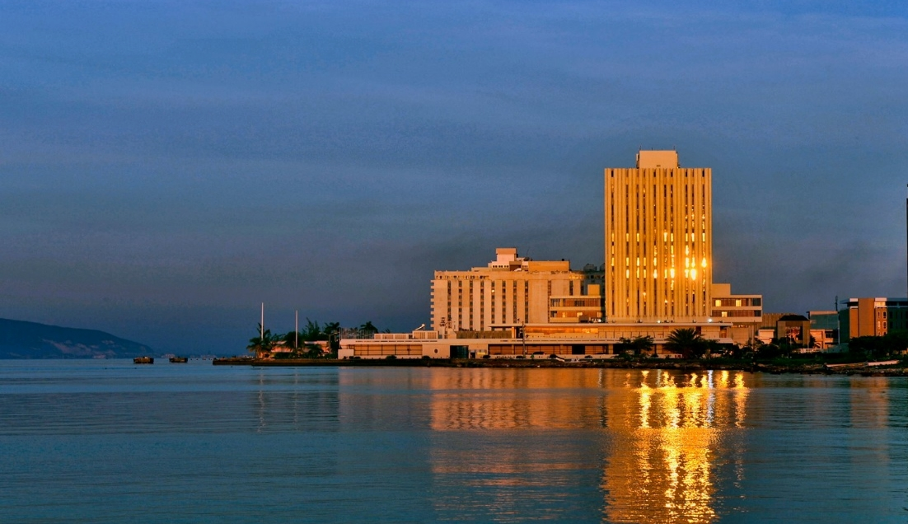

Microcredit Licensing:
- Application and Licensing process
- Completing the application form
Presented by: Bank of Jamaica
Updated: March 2026

Slide 2
DISCLAIMER
This presentation is for information purposes. It does not and is not intended to constitute professional legal advice nor does it seek to be an exhaustive statement of the law. You should obtain professional legal advice on any particular matter in or arising from the presentation which concerns you.

Slide 3
OUTLINE
The Microcredit Application and Licensing Process
The Fit and Proper Process
How to Complete The Microcredit Licensing Application Form
  General Instructions
  Completing the Application Form
Submitting the Application Form
Contact Information

Slide 4
The Microcredit Application and Licensing Process

Slide 5

THE APPLICATION PROCESS
WEBSITE
FORMS
COMPLETE
SUBMIT
1. Visit the Bank of Jamaica website
2. Download the forms
3. Complete in full
4. Submit to Bank of Jamaica
Review the Microcredit Act, Rules, Regulations and supporting guidance.
https://boj.org.jm/core-functions/financial-system/microcredit-regulation/microcredit-institutions/
Download the Microcredit Licence Application Fillable Form
&
The Microcredit Fit and Proper Personal Questionnaire
Complete the application form and Personal Questionnaire in full.
Append all required attachments and any other supporting documentation.
See Slide 38

Slide 6

THE LICENSING PROCESS
ACKNOWLEDGEMENT
SUFFICIENCY
DECISION
REGISTRY
1. Acknowledge Receipt
2. Sufficiency
3. Decision
4. Gazette and Registry updated
BOJ will acknowledge receipt within 5 business days.
Sufficiency assessment conducted within 10 days of acknowledgement
Where there are gaps, feedback is provided for remediation.
The process does not proceed until all information is received.
Decision within 90 days of receiving all information and documentation (outlined in sufficiency letter)
If approved - Fee payment notification issued
If refused – Applicant has the option to request a hearing within 14 days of such notification
Supervisor determines whether to uphold or overturn the decision
Gazette updated with relevant details of the licensee
Microcredit Registry at the Bank of Jamaica updated with licensee information.

Slide 7
THE FIT AND PROPER PROCESS
SUBMISSION
ASSESSMENT
DECISION
See presentation entitled “Completing the Fit and Proper Personal Questionnaire”

Slide 8
HOW TO COMPLETE THE MICROCREDIT LICENSING APPLICATION FORM

Slide 9
General Instructions
Download and fill out the form on a computer. (Applications are not to be hand written)
Answer all questions on the form unless instructed otherwise.
If a question does not apply, indicate “Not Applicable” in the space provided.
Provide evidence or supporting documentation for your responses, as much as possible.
Applicants may use additional sheet(s) of paper where space constraints do not allow for a fulsome response to a question on the application form. Where additional sheets are used, observe the following:
i) each additional sheet to be signed by the signatories to the application form;
ii) each additional sheet is to be dated;
iii) each additional sheet/page should contain the following statement:
This page forms part of and is to be read as one with the application
iv) the relevant question (to which the additional sheet relates) should make reference to the addendum/page annexed.
Each page of the application must be signed and dated.
The application must also be accompanied by a cover letter.

Slide 10
COMPLETING THE APPLICATION FORM
Question | Comment
1.1 Name of Applicant | Enter full name of the applicant as it appears on the incorporation or registration documents. Initials are not to be used unless they are a part of the registered name.
1.2 Trading Name, if different from 1.1 above | Enter trading name of the applicant e.g. Dunstan and Friends Finance Ltd. With trading name DAF Loans. DAF Loans is to be entered.
1.3 Registered Office Address | Enter the complete address as noted on the incorporation or registration documents.
1.4 Date of Incorporation (dd/mm/yyyy) | The date of incorporation as it appears on the incorporation documents. Enter in the format indicated day/month/year for example 12/07/2020

Slide 11
COMPLETING THE APPLICATION FORM
Question | Comment
1.5 Country of incorporation and registration number | The name of the country of incorporation and registration number.
1.6 Tax Registration Number (TRN) | Enter TRN information in the following format: 111-222-333
1.7 Is the applicant listed on a stock exchange? | Indicate whether the applicant is listed on a stock exchange by selecting YES or NO as appropriate.
1.8 Telephone Number(s) | Enter the business telephone number(s) in the following format: (876) 444-5566. A maximum of three (3) telephone numbers may be entered.
1.9 Fax Number | Enter the applicant’s fax number in the following format: (876) 444-5566.

Slide 12
COMPLETING THE APPLICATION FORM
Question | Comment
1.10 Email Address | The email address(es) provided should be the primary email address(es) at which the applicant may be reached on matters concerning the application.
1.11 Website Address | Enter the complete web address of the applicant.
1.12 Indicate the financial year end of the applicant (dd/mm) | Enter the date of the applicant’s financial year end in the format indicated day/month - for e.g. 31/12
1.13 Indicate the financial year end of the applicant's immediate parent entity (dd/mm) (where applicable) | Enter the date of the financial year end of the parent entity in the format indicated day/month - for e.g. 31/12

Slide 13
COMPLETING THE APPLICATION FORM
Questions 1.14 through to 1.19 apply only to applicants from an overseas jurisdiction.
Question | Comment
1.14 Head Office Address | The head office address is the main place where work is performed or business is carried on in any jurisdiction.
1.15 Country of Incorporation | Indicate the country in which the applicant was incorporated.
1.16 Address of Principal Office in Jamaica | Enter the complete address of the principal office to be established in Jamaica. The principal office is the main place where work is performed or business is carried on in Jamaica.
* Applicant from an overseas jurisdiction is a company which is –
incorporated outside of Jamaica and which engages in the provision of microcredit services outside of Jamaica;
regulated by a foreign regulator; and
desirous of providing microcredit services through the operations of a local branch of the company in Jamaica.

Slide 14
COMPLETING THE APPLICATION FORM
Questions 1.14 through to 1.19 apply only to applicants from an overseas jurisdiction.
Question | Comment
1.17 Name of officer who is to be the authorized agent in Jamaica | The full name (first, middle and last names) of an officer who will be the applicant’s authorized agent in Jamaica. This individual must reside in Jamaica.
1.18 Name of alternate to the officer who is to be the authorized agent in Jamaica | The full name (first, middle and last names) of another officer of the applicant, who will carry on the functions of the authorized agent named in 1.17 above, in the absence or inability of the authorized agent named above to carry out those functions. This individual must also reside in Jamaica.
1.19 Regulator in country of incorporation (if applicable): | Indicate the full name and address of the regulator/supervisor in country of incorporation.

Slide 15
COMPLETING THE APPLICATION FORM
Question | Comment
1.20 Attach certified copies of the incorporating documents as defined in the Act. | Licences will be issued only to companies registered to do business in Jamaica. See Section 2 (Interpretation) of the Microcredit Act, for the list of Incorporation documents. For an applicant from an overseas jurisdiction: Submit the certified copy of registration documents to operate a company in Jamaica, obtained from the Companies Office of Jamaica, along with relevant certified copies of incorporation documents from country of incorporation. Certified copies of incorporation documents are obtained from the relevant registrar of companies (e.g. in Jamaica - The Companies Office of Jamaica)

Slide 16
COMPLETING THE APPLICATION FORM
Question | Comment
1.21 Audit Firm/Public Accountant who last conducted the applicant’s external audit | State the name and complete address of the audit firm or public accountant who last conducted the applicant’s external audit or prepared the financial statements presented, as well as, the name of the primary contact. A list of Registered Public Accountants may be found on the website of the Public Accountancy Board, which may be accessed using the following web address: www.pab.gov.jm/list-of-rpas

Slide 17
COMPLETING THE APPLICATION FORM
Question | Comment
1.22 Attorney-at-law (where applicable) | State the name and complete address, of the applicant’s attorney as well as the name of the primary contact.
1.23 Banker/(s) (where applicable) | State the name and complete address, of the applicant’s banker as well as the name of the primary contact.

Slide 18
COMPLETING THE APPLICATION FORM
Question | Comment
2.1 Where applicable, state the name, address and principal business activities of the applicant’s holding company. Provide details of the amount and value of the shareholding of the holding company in the applicant. | Note section 2(5) of the Act, for the definition of holding company. Information provided should be supported by relevant documentation from the Companies Office of Jamaica.

Slide 19
COMPLETING THE APPLICATION FORM
Question | Comment
2.2 Provide a chart of the group structure which clearly outlines the relationships among all the connected persons (as defined under sections 2(1) and 2(4) of the Act) within the group of which the applicant is a part. The chart should highlight: The holding company and any other person with holdings of 20% or more of the voting power in the applicant; or Other person with the ability to exercise effective control over the applicant or over any other entity within the group that conducts activities or businesses that are considered material or critical to the group operations. Also provide the addresses of entities listed in the group. | Where the applicant is part of a group structure, provide by way of attachment/insertion in the application form details of the group structure. The group structure chart (family tree) Showing all connected persons within the group of which the applicant is a part (Refer to the Microcredit Act Sections 2(1) and 2(4)) for description of group and connected persons respectively).

Slide 20
COMPLETING THE APPLICATION FORM
Question | Comment
2.3 If applicable, provide a list of branches where microcredit services are offered or will be offered, and their addresses. | Review section 2 of the Act, where “branch” means an office or place of business (other than a principal office) where a microcredit institution carries on any microcredit service. Include all locations regardless of the configuration. Organize the list by clearly identifying stand alone and shared space locations. Where the applicant operates solely online, state: “No branches – microcredit services are delivered solely online” Indicate the full name/address of online platform used (e.g. website/an App/social media page….). Where the applicant delivers the service only by way of field operations (direct visits to the clients), state: “No branches – microcredit services are delivered only by way of field operations”.

Slide 21
COMPLETING THE APPLICATION FORM
Question | Comment
2.4 Indicate whether the provision of microcredit services is the main business of the applicant or ancillary thereto. | State – ‘main business’ or ‘ancillary business’ as applicable. Where ancillary, state the activity to which the microcredit service is ancillary. Typically, a business is ancillary to another business where the services offered differ from or enhance the main services or product lines of a company and is not a company's core product and service. Generally, provide details of any other businesses carried on by the applicant. NOTE: Provisions set out at section 31 of the Microcredit Act must be met.

Slide 22
COMPLETING THE APPLICATION FORM
Question | Comment
2.5 If applicable, state the names and addresses of all partnerships, unincorporated associations and other bodies that are connected with the applicant, and provide details of the nature of the applicant’s connection with these bodies. Explain the nature of the business and principal activities of these bodies and other connected persons and indicate which is considered as material to the activities of the group. | Review Section 2 (4) of the Act for an explanation of connected persons and provide the names and addresses of all partnerships, unincorporated associations and other bodies that are connected with the applicant. * Unincorporated associations refer to organizations formed to represent groups of people but are not incorporated.

Slide 23
COMPLETING THE APPLICATION FORM
Question | Comment
2.6 State whether the applicant is connected to a financial group under the Banking Services Act. | State whether there is a connection with any financial group as defined under section 2 of the Banking Services Act (BSA).
2.7 Provide the name of the stock exchange(s) on which the holding company at 2.1 and subsidiaries at 2.2 above is/are listed, if applicable. | If any company mentioned at 2.1 or 2.2 is publicly listed indicate which and the name of the stock exchange(s) on which they are listed.

Slide 24
COMPLETING THE APPLICATION FORM
Question | Comment
2.8 Provide details of persons who will, whether alone or jointly, possess or control 10% or more of the shares or voting power of the applicant to include – in the case of a natural person, the name, nationality, occupation, address (home and business), shareholding and voting power in the applicant; in the case of a legal person, the name, registered address, nature of business, shareholding and voting power in the applicant; and number, type, class and value of shares held in each case. | Where persons whether acting alone or jointly with another will control 10% or more of shares or voting power of the applicant, provide the details requested.

Slide 25
COMPLETING THE APPLICATION FORM
Question | Comment
2.9 If there are no such persons as required at 2.8 above, provide similar details for each of the 10 largest shareholders, grouping together family or connected persons. | See Section 2 of the Act for a detailed definition of connected persons.
2.10 In cases where a legal person owns 50% or more of the applicant, the applicant must provide the name and address for all the ultimate natural persons who hold 20% or more of the voting shares of that legal person or the ultimate natural persons who have effective control thereof. | Per the Act effective control means, the ability of a person (whether acting alone, or jointly with another) to ensure that the affairs of the licensee or other company are conducted in accordance with the wishes of that person, whether or not the person has control of the licensee or other company.

Slide 26
COMPLETING THE APPLICATION FORM
Question | Comment
2.11 Provide audited financial statements for the past 3 years for the immediate holding company of the applicant. If the holding company of the applicant is a small company and qualifies for the approach reflected at section 35(2) of the Act, provide copies of the financial statements so prepared for the last three years or less, (where applicable). | If a small company, please refer to: Section 35 (2) of the Microcredit Act, 2021 The Companies Act of Jamaica Schedule 7, for a detailed description of companies that qualify as a small company. A list of Registered Public Accountants may be found on the website of the Public Accountancy Board, which may be accessed using the following web address: www.pab.gov.jm/list-of-rpas

Slide 27
COMPLETING THE APPLICATION FORM
Question | Comment
2.12 Indicate whether any of the natural persons referred to in your responses to: 1.17 - Name of officer who is to be the authorized agent in Jamaica 1.18 - Name of alternate to the officer who is to be the authorized agent in Jamaica 2.8(a) - natural persons who will, whether alone or jointly, possess or control 1-0% or more of the shares or voting power of the applicant 2.9 – If no such persons at 2.8, each of the 10 largest shareholders, grouping together family or connected persons. 2.10 - legal person owns 50% or more of the applicant, details for all the ultimate natural persons who hold 20% or more of the voting shares of that legal person or the ultimate natural persons who have effective control thereof. 3.1 each officer of the applicant, and where applicable, of its holding company. 3.2 each person to be appointed (at commencement) or who now operates as a director, secretary, or other officer of the applicant; is a Politically Exposed Person (PEP). | If YES, State the full name and the factors contributing to this classification. Review The Microcredit (Requirements for Grant of Licence) Regulations, 2021 and referenced legislation for a full definition of PEPs. PEPs could include but not limited to a : Head of State or Government Military official or police above the rank of Captain or of or above the rank of Assistant Commissioner respectively Permanent Secretary, Chief Technical Director or chief officer in the charge of the operations of a Ministry, department of Government, executive agency or statutory body, as the case may be, or An individual who is a relative or is known to be a close associate of any such person listed in the definition. This list is not exhaustive, please refer to the legislation for a comprehensive list of Politically Exposed Persons.

Slide 28
COMPLETING THE APPLICATION FORM
Question | Comment
2.13 List all the ultimate beneficial owners of the applicant and provide copies of the identification of such ultimate beneficial owners. | Refer to The Microcredit (Licence, Form of Application) Rules, 2021 for a definition of ultimate beneficial owners. Acceptable identification are Government-issued identification: Passport, Driver’s License, or the Jamaican Voter Registration Card. Copies of identification card should be in color (not black and white).

Slide 29
COMPLETING THE APPLICATION FORM
Question | Comment
3.1 Provide the name, address, nationality, occupation and proposed (or existing, as the case may be) responsibilities of each officer of the applicant, and where applicable, of its holding company. | Note the definition for Officer in section 2 of the Act. Per the Act officer in relation to a microcredit institution means, a person who, in that institution — is a director, president or vice-president (however designated), general manager, company secretary, financial controller or treasurer; or (b) performs functions similar to those normally performed by the holder of any position referred to in paragraph (a);

Slide 30
COMPLETING THE APPLICATION FORM:
Question | Comment
3.2 Provide – details of the personal and business history of each person to be appointed (at commencement) or who now operates as a director, secretary, or other officer of the applicant; and in relation to each of these persons, a completed “Personal Questionnaire for Connected Persons” (PQ) and related attachments. | Relevant persons complete the Microcredit Fit and Proper Personal Questionnaire, and applicant includes same in the application package. The referenced Personal Questionnaire is available on the website at the following link: Microcredit Institutions » Bank of Jamaica (boj.org.jm). Include a summary of the due diligence assessment conducted by the applicant: Assess the individual’s probity, financial soundness and competence. (See Standard of Sound Practice on Fit and Proper Assessments for Microcredit) Inform the applicant’s recommendation on the fitness and propriety of the substantial shareholders and officers.

Slide 31
COMPLETING THE APPLICATION FORM
Question | Comment
3.3 Provide clear details of the organizational structure and reporting lines proposed to inform the compliance of the applicant with its statutory obligations under the Principal Act and Regulations thereunder, the Proceeds of Crime Act, the Terrorism Prevention Act, the United Nations Security Council Resolution Implementation Act and Regulations thereunder and any other enactment. | Explain the organizational structure and the reporting lines in place or to be explicitly established to achieve compliance with statutory obligations.
3.4 With respect to 3.3 above provide a copy of the manual(s) that may be in place or that will be implemented in this regard. | The manual should clearly demonstrate the applicant’s understanding of its obligations and risks.

Slide 32
COMPLETING THE APPLICATION FORM
Question | Comment
3.5 Provide clear details regarding: the proposed internal audit function or mechanism that is in place or which is to be established by the applicant, the resources in place or to be employed and the relevant reporting and accountability structures. | The internal audit function/mechanism should be appropriate to the size and complexity of the applicant while ensuring minimum standards, adequate oversight and accountability.

Slide 33
COMPLETING THE APPLICATION FORM
Question | Comment
4.1 “Provide – copies of audited financial statements (Balance Sheet, Profit & Loss, Auditor’s Report and Notes) for the last three years or less (where applicable); For persons who qualify for the approach reflected at section 35(2) of the Act, provide copies of the financial statements so prepared for the last three years or less (where applicable); and (b) “In-house” financials for the current operating period. | See Section 35(2) of the Microcredit Act Small Companies: Please also refer to the Companies Act of Jamaica, Schedule 7, for a detailed description of companies that qualify as a small company. Where qualified - the accounts can be prepared by an external auditor, who is registered public accountant appointed by the licensee. At the submission of its application for licensing, a start up would be expected to provide a: Business Case Financial projections for three years, and Proforma Financial statements A list of Registered Public Accountants may be found on the website of the Public Accountancy Board, which may be accessed using the following web address: www.pab.gov.jm/list-of-rpas

Slide 34
COMPLETING THE APPLICATION FORM
Question | Comment
5.1 Provide details regarding the nature and source of wealth of the applicant. | Source of wealth refers to the origin of the total assets the applicant has. The information presented should: - give an indication regarding, The total volume of wealth the applicant has The form in which it is held A clear description of how it was acquired - Accompanied by a Statement of Affairs

Slide 35
COMPLETING THE APPLICATION FORM
Question | Comment
5.2 Provide details regarding the source of funds that will be provided or have been provided to support the start-up and ongoing operations of the proposed lending activities or of the existing lending activities, as the case may be, of the applicant. | Source of Funds refer to the origin of the particular funds or assets which are to be used for funding the business operations. Provide: A statement/declaration about the actual source(s) of fund, Supporting documents, and Independent verification (depending on materiality). Example: Savings / deposits - Bank account statement(s) - Documentation to support the source of funds to the bank account(s).

Slide 36
Attachments
All items should be included in the application package.
Indicate inclusion by way of a tick (√ ).

Slide 37
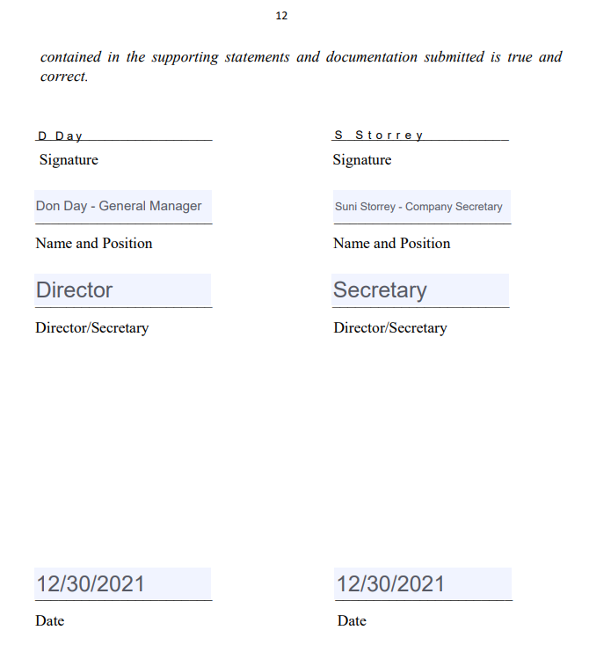
Declaration
The Declaration on the form of application is to be filled as follows:

Slide 38
Submitting the Application Package
The completed Microcredit Licensing Form of Application and Fit and Proper Personal Questionnaire, along with supporting documents (the application package), should be submitted to Bank of Jamaica as follows:
Microcredit Form of Application, and its supporting documents (as outlined on pages 10-11 of The Form of Application): | Submit via email to FISDMailbox@boj.org.jm, with FISDApprovals@boj.org.jm on copy.
The Fit and Proper Personal Questionnaire and its supporting documents (as outlined on slide 24 of presentation entitled Completing the Fit and Proper Personal Questionnaire). | Submit via email and hard copy as outlined on slide 24 of presentation entitled Completing the Fit and Proper Personal Questionnaire.

Slide 39
Contact
Information
For guidance or additional information in relation to Licensing, contact our Licensing and Approvals Department: Via email at: FISDMailbox@boj.org.jm, with FISDApprovals@boj.org.jm on copy, or Via telephone at: (876) 922-0750, extension 7012 | For guidance or additional information in relation to Fitness and Probity, contact our Fit and Proper Department: Via email at: FISDMailbox@boj.org.jm Via telephone at: (876) 922-0750

